Slide 1
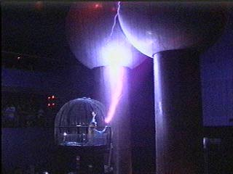

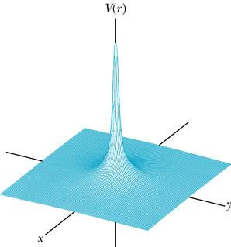
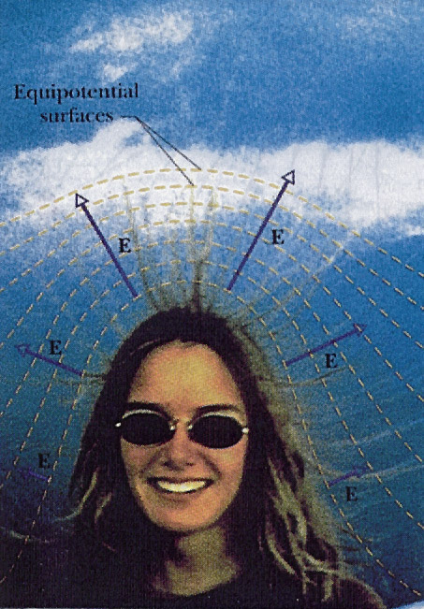
Physics 102
Physics 2113
Jonathan Dowling
Electric Potential
Danger!

Slide 2
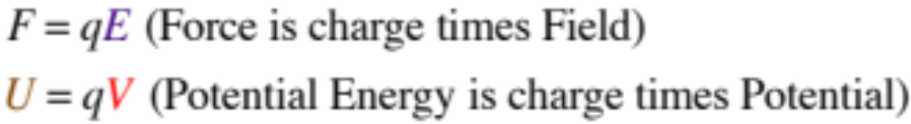
Electric Potential Energy,
Electric Potential
Units :
Potential Energy = U = [J] = Joules
Electric Potential = V = U/q = [J/C] = [Nm/C] = [V] = Volts
Electric Field = E = [N/C] = [V/m] = Volts per meter
Electron Volt = 1eV = Work Needed to Move an Electron Through a Potential Difference of 1V:
W = qΔV = e x 1V = 1.60 10^{–19} C x 1J/C = 1.60 10^{–19} J

Slide 3
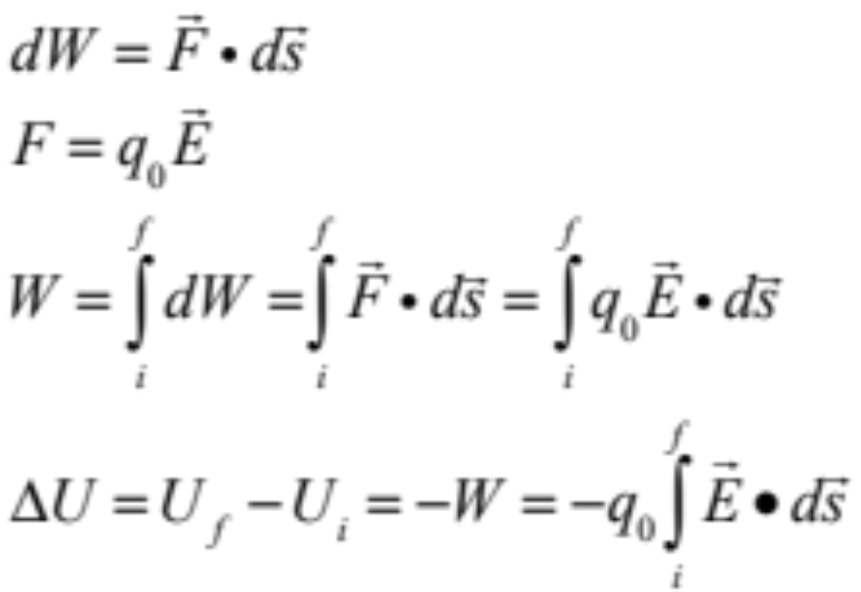
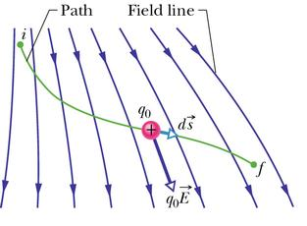
Electric Potential Energy = Joules
Electric potential energy difference ΔU between two points = work needed to move a charge between the two points:
ΔU = U_{f} – U_{i} = –W

Slide 4
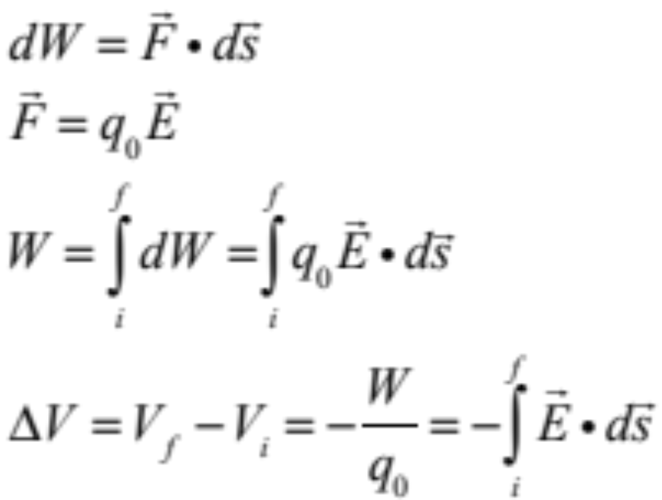
Electric Potential Voltage = Volts = Joules/Coulomb!
Electric potential — voltage! — difference ΔV between two points = work per unit charge needed to move a charge between the two points:
ΔV = V_{f} – V_{i} = –W/q = ΔU/q

Slide 5
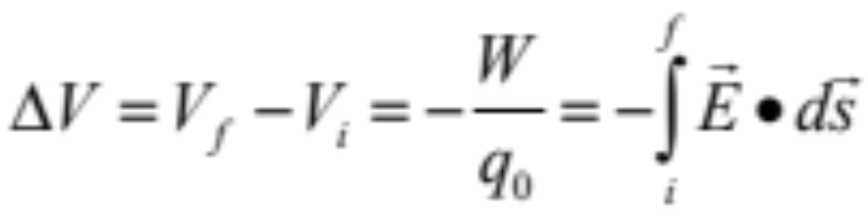

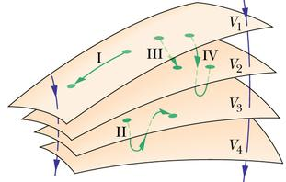
Equal-Potential = Equipotential Surfaces
• The Electric Field is Tangent to the Field Lines
Equipotential Surfaces are Perpendicular to Field Lines
Work Is Needed to Move a Charge Along a Field Line.
No Work Is Needed to Move a Charge Along an Equipotential Surface (Or Back to the Surface Where it Started).
Electric Field Lines Always Point Towards Equipotential Surfaces With Lower Potential.

Slide 6
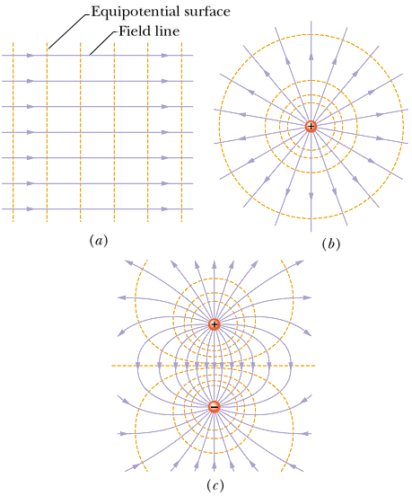

Electric Field Lines and Equipotential Surfaces
Why am I smiling?
I’m About to Be
Struck by
Lightning!
http://www.cco.caltech.edu/~phys1/java/phys1/EField/EField.html

Slide 7
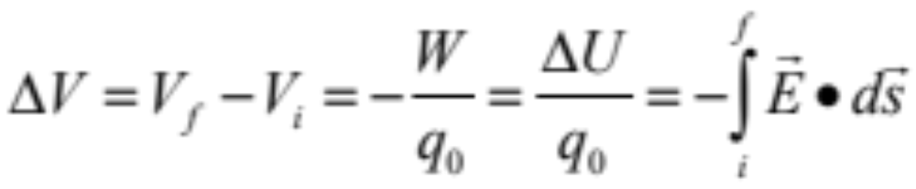
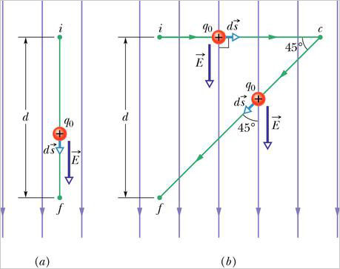
Conservative Forces
The potential difference between two points is independent of the path taken to calculate it: electric forces are “conservative”.

Slide 8
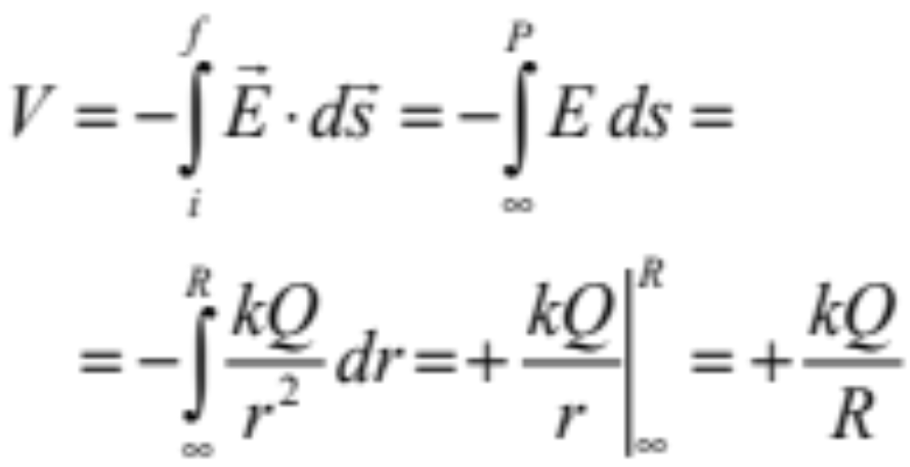
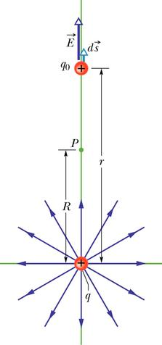
Electric Potential of a Point Charge
Bring imaginary + test charge q₀ in from infinity!
Note: if q were a
negative charge,
V would be negative
If q₀ and are both + charges
as shown, is the Work needed to bring q₀ from ∞ to P + or –?

Slide 9
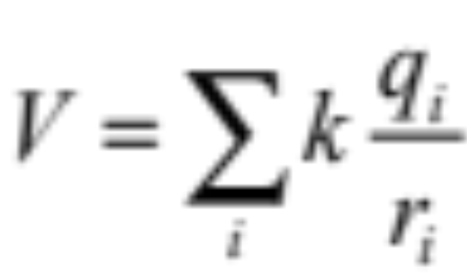
Electric Potential of Many Point Charges
Electric potential is a SCALAR not a vector.
Just calculate the potential due to each individual point charge, and add together! (Make sure you get the SIGNS correct!)
q₄
q₃
r₃
r₄
P
r₂
q₅
r₅
q₂
r₁
q₁

Slide 10
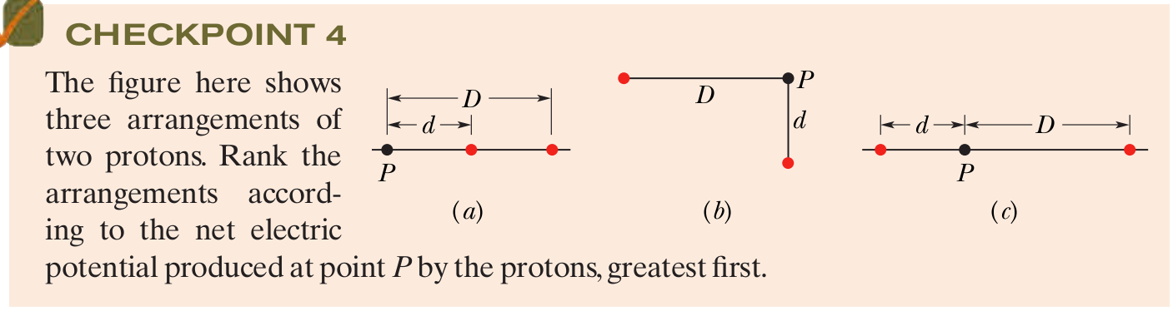



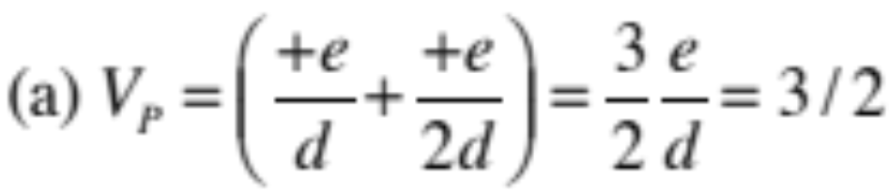
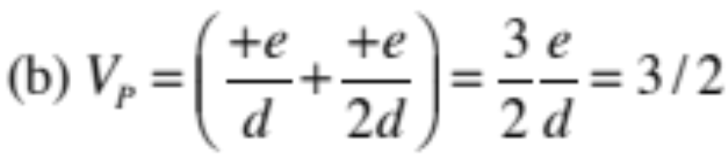
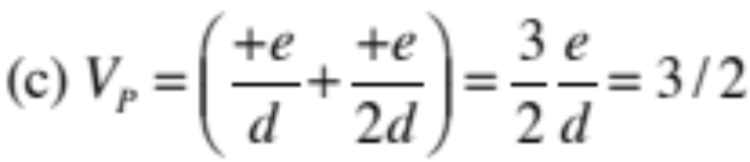
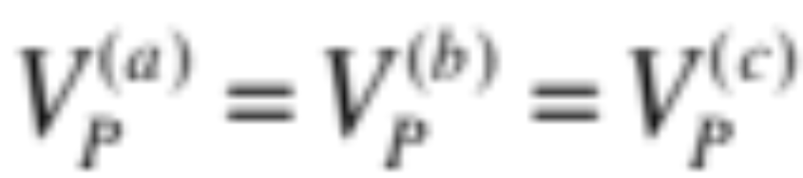
No vectors!
Just add with sign.
One over distance.
Since all charges same and all distances same all potentials same.

Slide 11




ICPP:
–Q
Positive and negative charges of equal magnitude Q are held in a circle of radius r.
1. What is the electric potential voltage at the center of each circle?
V_{A} =
V_{B} =
V_{C} =
2. Draw an arrow representing the approximate direction of the electric field at the center of each circle.
3. Which system has the highest potential energy?
+Q
A
B
C
U_{A} =+q₀V_{A} has largest positive un-canceled charge

Slide 12

Potential Energy of A System of Charges
4 point charges (each +Q and equal mass) are connected by strings, forming a square of side L
If all four strings suddenly snap, what is the kinetic energy of each charge when they are very far apart?
Use conservation of energy:
  Final kinetic energy of all four charges = initial potential energy stored = energy required to assemble the system of charges
  If each charge has mass m, find the velocity of each charge long after the string snaps.
+Q
+Q
+Q
+Q
Let’s do this from scratch!

Slide 13
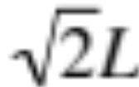
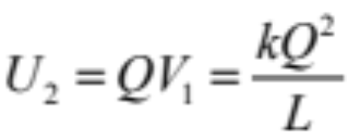
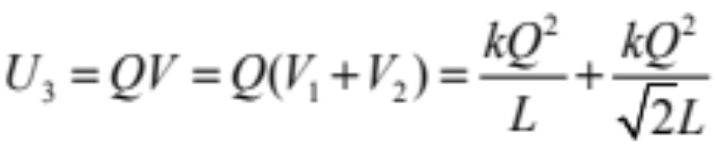
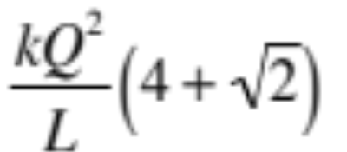
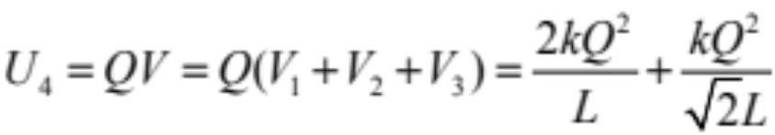
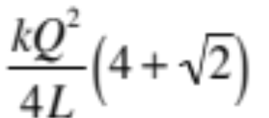
Potential Energy of A System of Charges: Solution
L
+Q
+Q
No energy needed to bring in first charge: U₁=0
Energy needed to bring in 2nd charge:
+Q
+Q
Energy needed to bring in 3rd charge =
Total potential energy is sum of all the individual terms shown on left hand side =
Energy needed to bring in 4th charge =
So, final kinetic energy of each charge =K=mv²/2 =

Slide 14
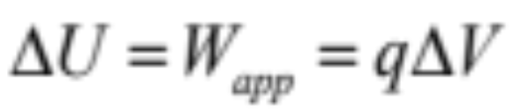
Potential Energy of a Dipole
+Q
–Q
a
+Q
–Q
a
What is the potential energy of a dipole?
First: Bring charge +Q: no work involved, no potential energy.
The charge +Q has created an electric potential everywhere, V(r) = kQ/r
Second: The work needed to bring the charge –Q to a distance a from the charge +Q is W_{app} = U = (-Q)V = (–Q)(+kQ/a) = -kQ²/a
The dipole has a negative potential energy equal to -kQ²/a: we had to do negative work to build the dipole (electric field did positive work).

Slide 15
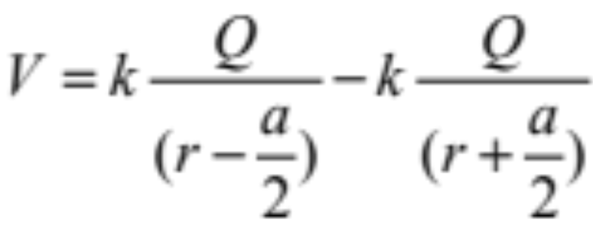
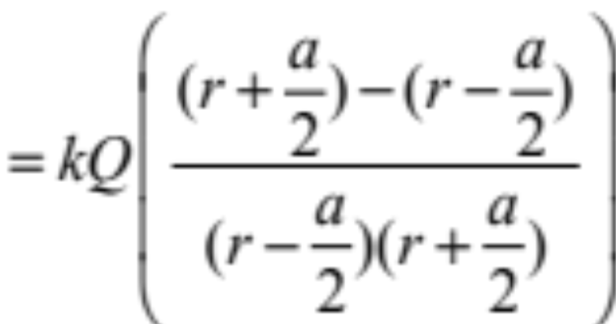
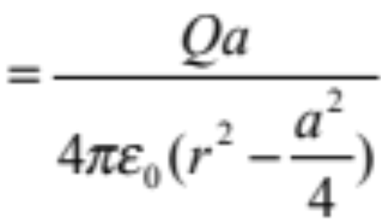
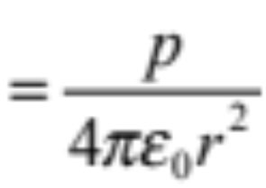
Electric Potential of a Dipole (on axis)
What is V at a point at an axial distance r away from the midpoint of a dipole (on side of positive charge)?
p
a
–Q
+Q
r
Far away, when r >> a:
V

Slide 16
IPPC: Electric Potential on Perpendicular Bisector of Dipole
You bring a charge of Q_{o} = –3C from infinity to a point P on the perpendicular bisector of a dipole as shown. Is the work that you do:
  Positive?
  Negative?
  Zero?
a
-Q
+Q
d
P
U = Q_{o}V = Q_{o}(–Q/d+Q/d) = 0
–3C

Slide 17
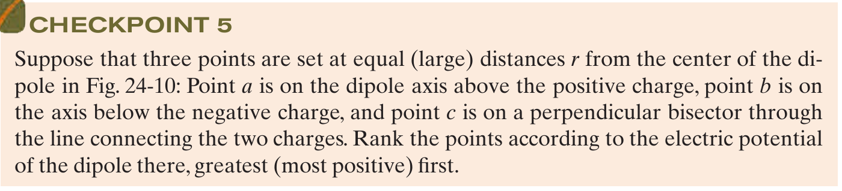

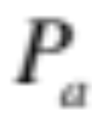
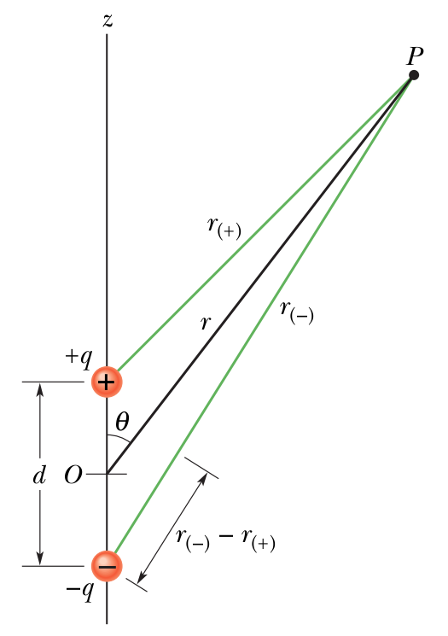



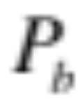

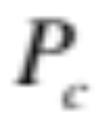

Slide 18
Summary:
Electric potential: work needed to bring +1C from infinity; units V = Volt
Electric potential uniquely defined for every point in space -- independent of path!
Electric potential is a scalar — add contributions from individual point charges
We calculated the electric potential produced by a single charge: V=kq/r, and by continuous charge distributions:
dV=kdq/r
Electric potential energy: work used to build the system, charge by charge. Use W=qV for each charge.

Slide 20
